Slide 1
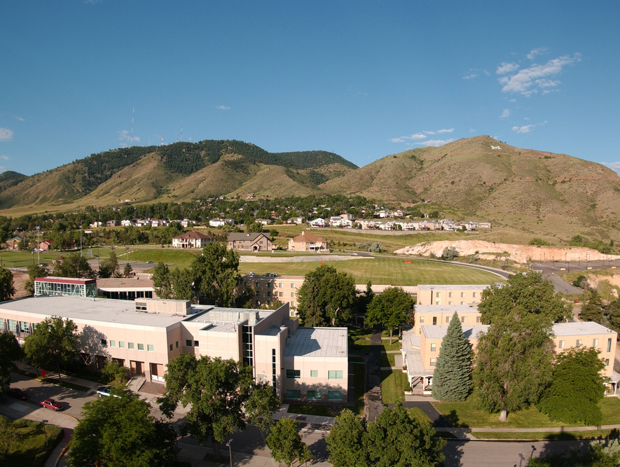
Colorado School of Mines
Computer Vision
Professor William Hoff
Dept of Computer Science
http://inside.mines.edu/~whoff/

Slide 2
Additional Topics related to Transforms

Slide 3
Plotting in 3D
It’s useful to plot your scene in 3D
Namely, draw the coordinate frames as xyz axes
You can verify that they are in the correct place
We’ll use the “matplotlib” module (you will need to download this module in order to use it)
{B}
{A}

Slide 4
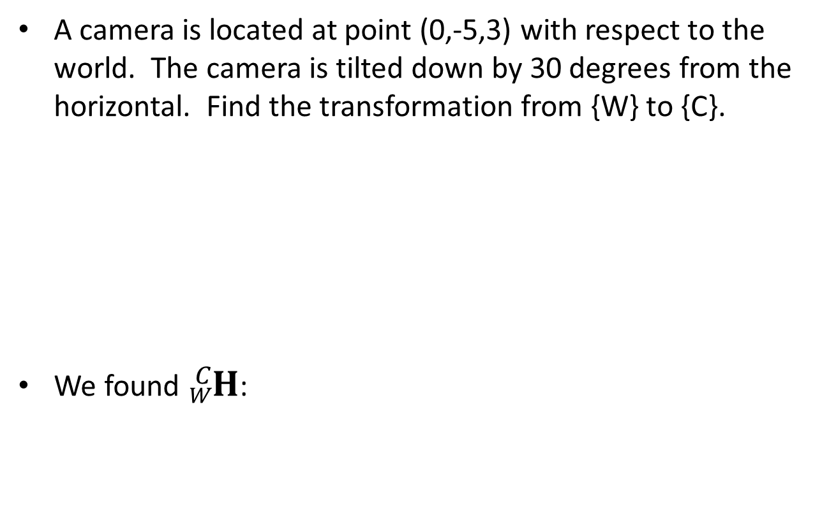
Example from earlier lecture slides
A camera is located at point (0,-5,3) with respect to the world. The camera is tilted down by 30 degrees from the horizontal. Find the transformation from {W} to {C}.
We found ${}_{W}^{C}H$:
{C}
z
y
z
y
{W}
1.0000 0 0 0
0 -0.5000 -0.8660 0.0981
0 0.8660 -0.5000 5.8301
0 0 0 1.0000

Slide 5
We can plot the scene in 3D using Matplotlib
Add this in the main program:
Also add this function:
import matplotlib.pyplot as plt # Import these at the beginning of your program
from mpl_toolkits.mplot3d import Axes3D
# Draw scene in 3D.
fig = plt.figure()
ax = fig.add_subplot(111, projection='3d')
ax.set_xlabel('x')
ax.set_ylabel('y')
ax.set_zlabel('z')
draw_coordinate_axes(ax, np.eye(4), 'W')
draw_coordinate_axes(ax, H_c_w, 'C')
setAxesEqual(ax)
plt.show() # This shows the plot, and pauses until you close the figure
# Draw three 3D line segments, representing xyz unit axes, onto the axis figure ax.
# H is the 4x4 transformation matrix representing the pose of the coordinate frame.
def draw_coordinate_axes(ax, H, label):
p = H[0:3, 3] # Origin of the coordinate frame
ux = H @ np.array([1,0,0,1]) # Tip of the x axis
uy = H @ np.array([0,1,0,1]) # Tip of the y axis
uz = H @ np.array([0,0,1,1]) # Tip of the z axis
ax.plot(xs=[p[0], ux[0]], ys=[p[1], ux[1]], zs=[p[2], ux[2]], c='r') # x axis
ax.plot(xs=[p[0], uy[0]], ys=[p[1], uy[1]], zs=[p[2], uy[2]], c='g') # y axis
ax.plot(xs=[p[0], uz[0]], ys=[p[1], uz[1]], zs=[p[2], uz[2]], c='b') # z axis
ax.text(p[0], p[1], p[2], label) # Also draw the label of the coordinate frame

Slide 6
Useful function for forcing your axes to have equal scale
Call this function before calling “plt.show()”
############################################################
# Utility function for 3D plots.
def setAxesEqual(ax):
'''Make axes of 3D plot have equal scale so that spheres appear as spheres,
cubes as cubes, etc.. This is one possible solution to Matplotlib's
ax.set_aspect('equal') and ax.axis('equal') not working for 3D.
Input
ax: a matplotlib axis, e.g., as output from plt.gca().
'''
x_limits = ax.get_xlim3d()
y_limits = ax.get_ylim3d()
z_limits = ax.get_zlim3d()
x_range = abs(x_limits[1] - x_limits[0])
x_middle = np.mean(x_limits)
y_range = abs(y_limits[1] - y_limits[0])
y_middle = np.mean(y_limits)
z_range = abs(z_limits[1] - z_limits[0])
z_middle = np.mean(z_limits)
# The plot bounding box is a sphere in the sense of the infinity
# norm, hence I call half the max range the plot radius.
plot_radius = 0.5 * max([x_range, y_range, z_range])
ax.set_xlim3d([x_middle - plot_radius, x_middle + plot_radius])
ax.set_ylim3d([y_middle - plot_radius, y_middle + plot_radius])
ax.set_zlim3d([z_middle - plot_radius, z_middle + plot_radius])
############################################################

Slide 7
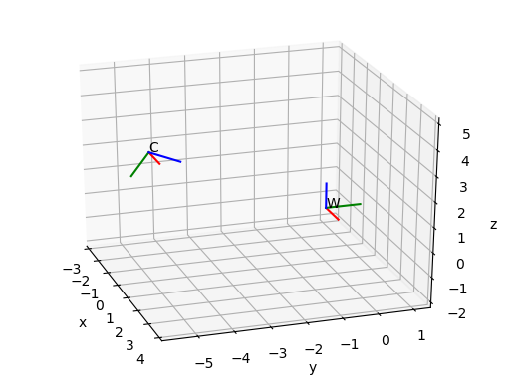
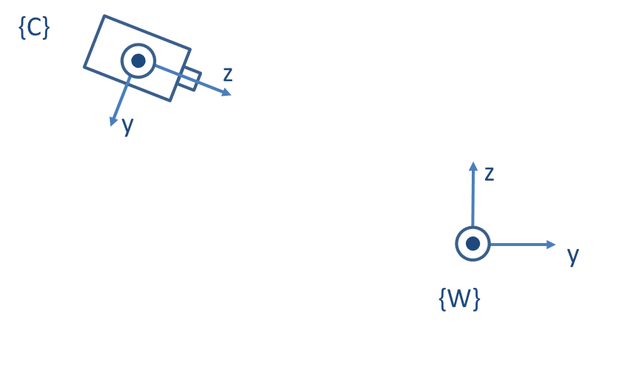
3D Plot
A camera is located at point (0,-5,3) with respect to the world. The camera is tilted down by 30 degrees from the horizontal.
The 3D rendering matches the original description of the problem

Slide 8
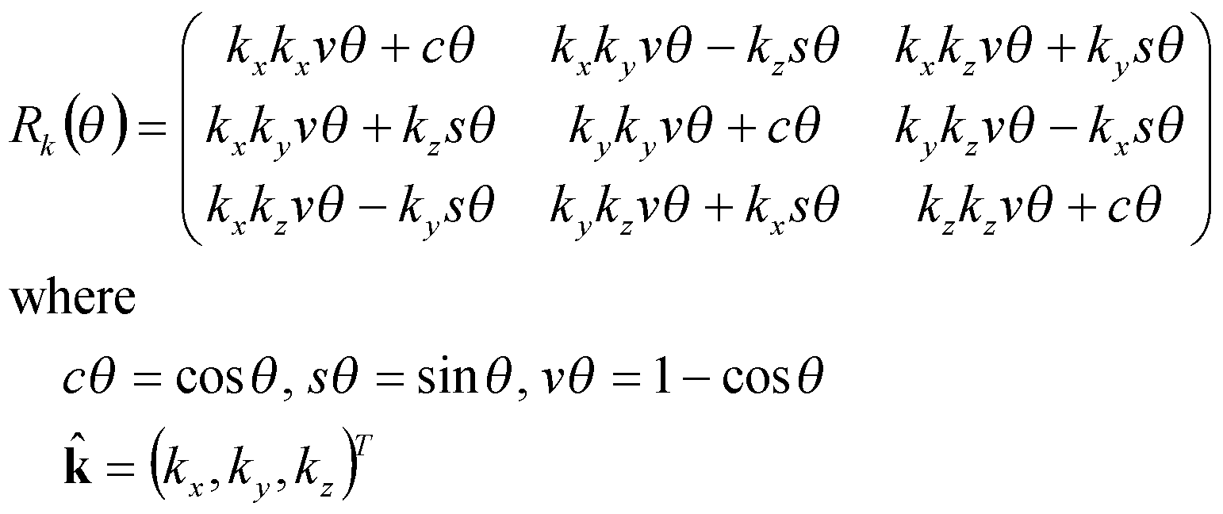
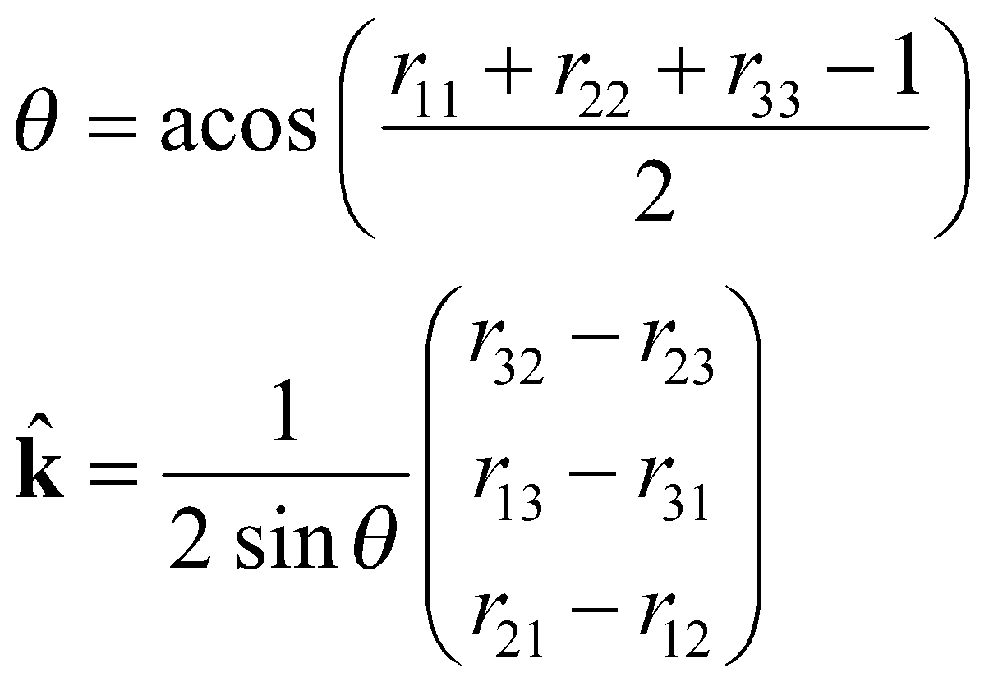
Equivalent Angle-Axis
k
A general rotation can be expressed as a rotation θ about an axis k
The inverse solution (i.e., given a rotation matrix, find k and θ):
The product of the unit vector k and angle θ , ω = θ k = (ω_{x}, ω_{y}, ω_{z}) is a minimal representation for a 3D rotation
θ
{B}
{A}
Note that (-k,-θ) is also a solution
8

Slide 9
def axis_angle_to_rot(k, ang):
# Convert orientation from axis, angle to rotation matrix.
# Angle is represented in radians. Returns 3x3 rotation matrix.
kx = k[0]
ky = k[1]
kz = k[2]
ca = math.cos(ang)
sa = math.sin(ang)
va = 1 - ca
return np.array([
[kx*kx*va + ca, kx*ky*va - kz*sa, kx*kz*va + ky*sa],
[kx*ky*va + kz*sa, ky*ky*va + ca, ky*kz*va - kx*sa],
[kx*kz*va - ky*sa, ky*kz*va + kx*sa, kz*kz*va + ca ]])

Slide 10
Repeating the previous example
{C}
z
y
z
{W}
y
R:
[[ 1. 0. 0. ]
[ 0. -0.5 0.8660254]
[ 0. -0.8660254 -0.5 ]]
k = np.array([1,0,0])
az = np.deg2rad(-120)
R = axis_angle_to_rot(k, az)
10

Slide 11
Back Projection
If you have an image point, you can “back project” that point into the scene
However, the resulting 3D point is not uniquely defined
  It is actually a ray emanating from the camera center, out through the image point, to infinity
  Any 3D point along that ray could have projected to the image point
First, we convert the image point to “normalized” coordinates
x_{norm}
r = sx_{norm} is a ray emanating outward to infinity

Slide 12
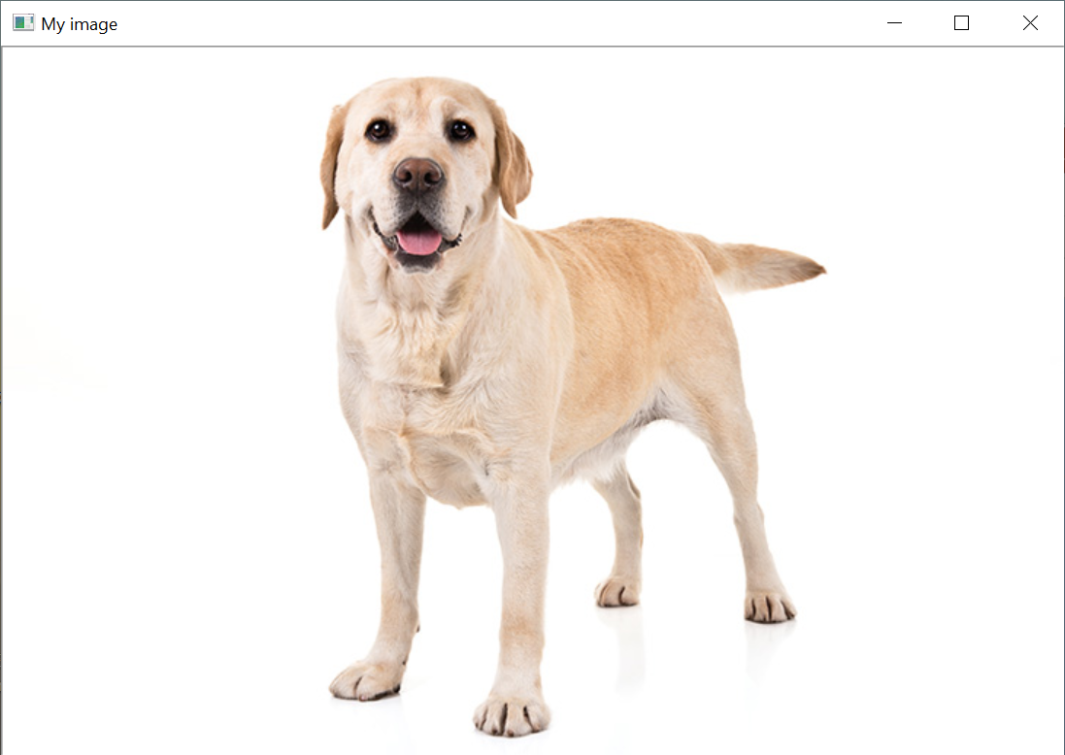
Example
Assume that the dog image was taken using a camera with focal length = 600 pixels, with cx,cy in middle of image.
  Find the unit vector in the direction of the dog’s nose

Slide 13

Solution:
  Find the location of the nose manually: it is at pixel (ximg=284, yimg=87)
  Then, pimg = K*pn, or pn = Kinv*pimg
  The unit vector to the nose is u = pn/norm(pn)
def main():
# Download an image from the web and save it to a file.
url = "https://s3.amazonaws.com/cdn-origin-etr.akc.org/wp-content/uploads/2019/12/03202400/Yellow-Labrador-Retriever.jpg"
urllib.request.urlretrieve(url, "myimage.jpg")
img = cv2.imread("myimage.jpg")
img_height = img.shape[0]
img_width = img.shape[1]
cx = img_width/2
cy = img_height/2
f = 600
K = np.array(((f, 0, cx), (0, f, cy), (0, 0, 1)))
x_nose = 284
y_nose = 87
cv2.circle(img, (x_nose, y_nose), radius=8, color=(0,255,0))
win_name = "My image"
cv2.imshow(win_name, img)
pn = np.linalg.inv(K) @ np.array([x_nose, y_nose, 1])
u = pn / np.linalg.norm(pn)
print(u)
cv2.waitKey(0)
print("All done!")
[-0.12876848 -0.24953892 0.95976508]

Slide 14
Weak Perspective
Sometimes it is better to use an approximation to perspective projection, called “weak” projection or scaled orthography
This works if the average depth Z_{avg} to an object is much larger than the variation in depth within the object
  Instead of x = f X/Z, y = f Y/Z
  use x = f X/Z_{avg}, y = f Y/Z_{avg}
This makes the image coordinates (x,y) a linear function of the 3D coordinates (X,Y,Z)

Slide 15
Comparison of perspective and weak perspective
A cube, rendered in true perspective
The same cube, rendered in weak perspective

Slide 16
Special Case
Small planar patch
  Often we want to track a small patch on an object
  We want to know how the image of that patch transforms as the object rotates
Assume
  Size of patch small compared to distance -> weak perspective
  Rotation is small -> small angle approximation
  Patch is planar
It can be shown that the patch undergoes affine transformation

